Slide 1
SharePoint Framework Extensions and You
SharePoint Saturday Omaha
April 7, 2018
Presented By
Ryan Schouten

Slide 2





About Me
Ryan Schouten
Utah SharePoint User Group President
Worked with SharePoint for > 10 years
I have experience with SharePoint 2003 – 2016
I have worked with ASP.Net for 16 years
Microsoft MVP – Office Servers and Services
http://www.sharepointknight.com

Slide 3













Thank You
Sponsors!

Slide 4


Slide 5
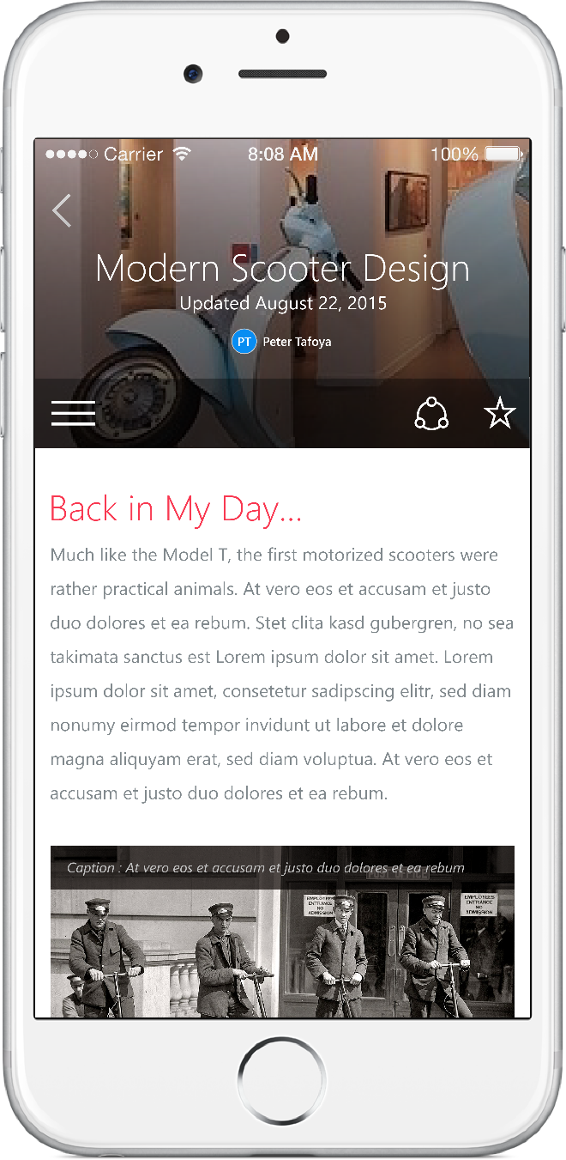
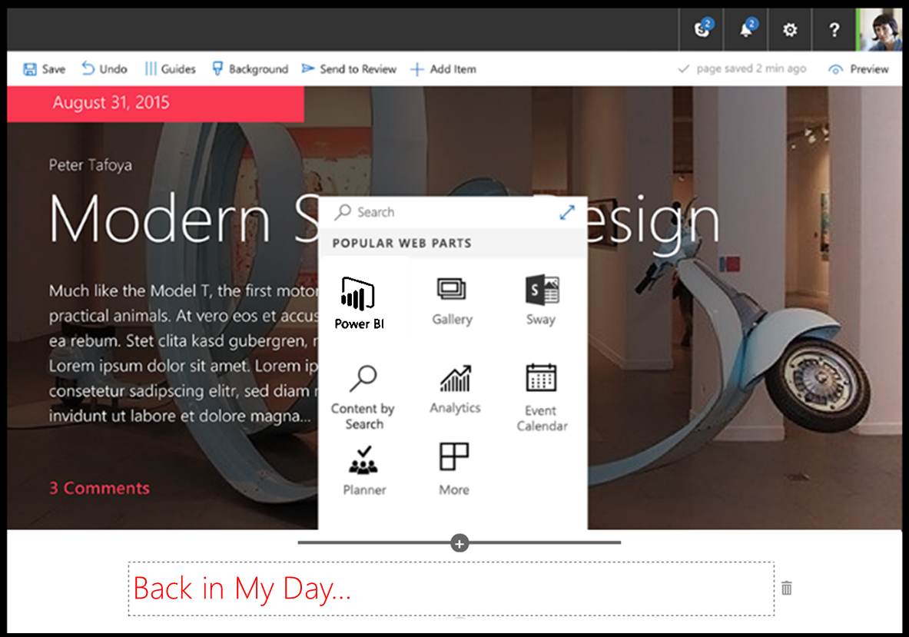
SharePoint Framework (SPFx)
Modern client-side development
Lightweight web and mobile
Powers our own experiences
Backward compatible
Supports open source tools and JavaScript web frameworks
SharePoint framework
Microsoft Graph
LOB Systems and Cloud Services
5

Slide 6









Open source tooling
Build Process & Tooling
JavaScript Frameworks
Code Editors
Yeoman Templates Gulp-based Build Process NodeJS/NPM SystemJS Webpack SASS TypeScript
React Angular
Knockout
and more … your choice!
Visual Studio Code Atom Sublime
and more … your choice!
6

Slide 7




Server side tool comparison
IIS Express
C#
MSBuild
Project Templates
7

Slide 8
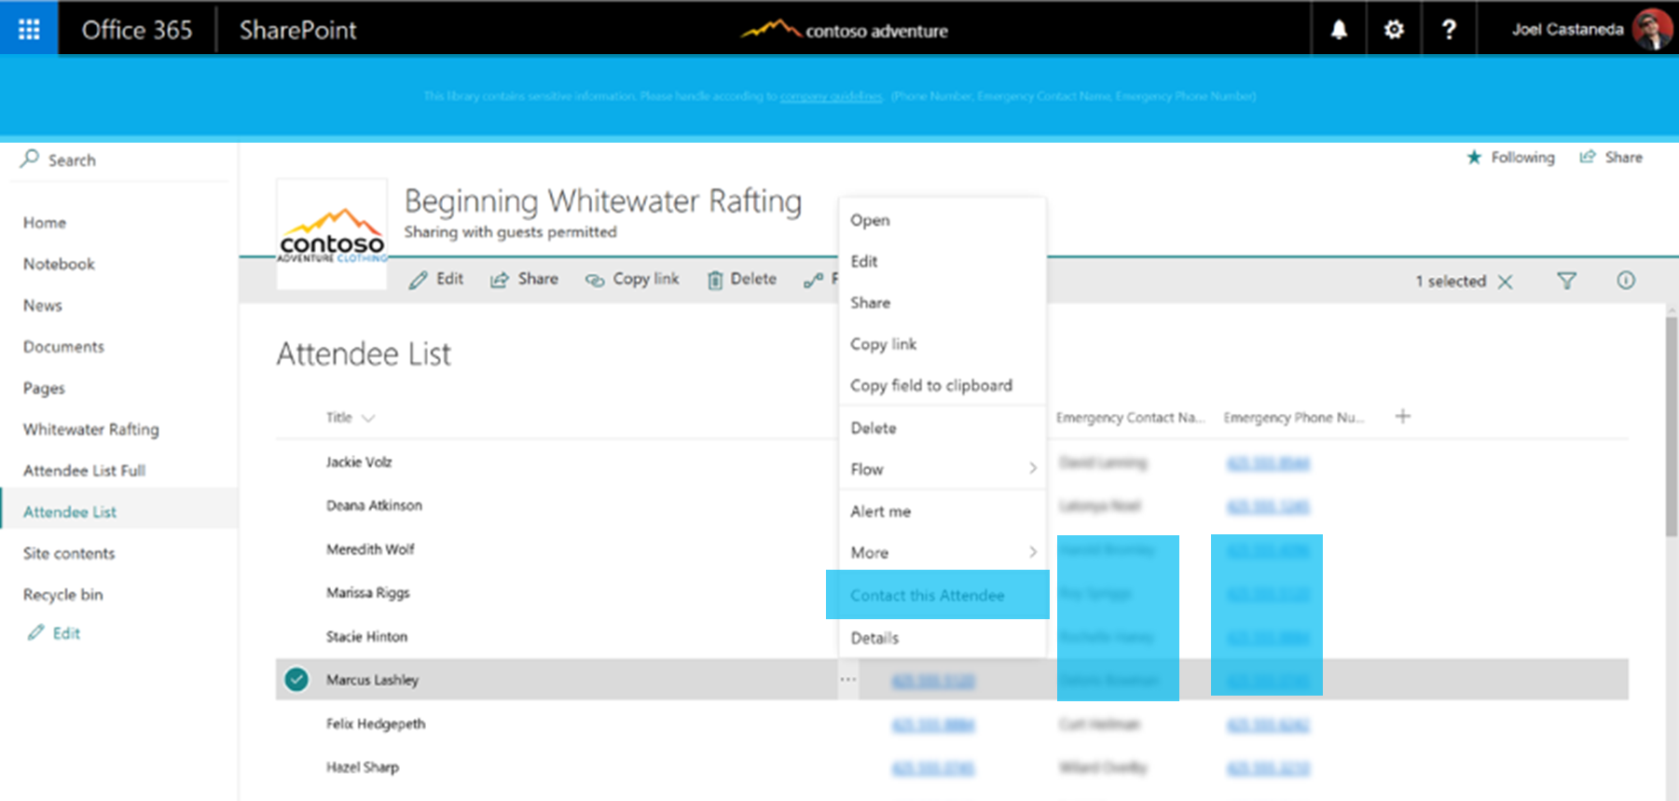
SharePoint Framework Extensions
Application customizer to extend UI or embed JavaScript
ListView Command Set for adding new buttons to toolbar or context menu
Field customizer to modify rendering of a field
8

Slide 9
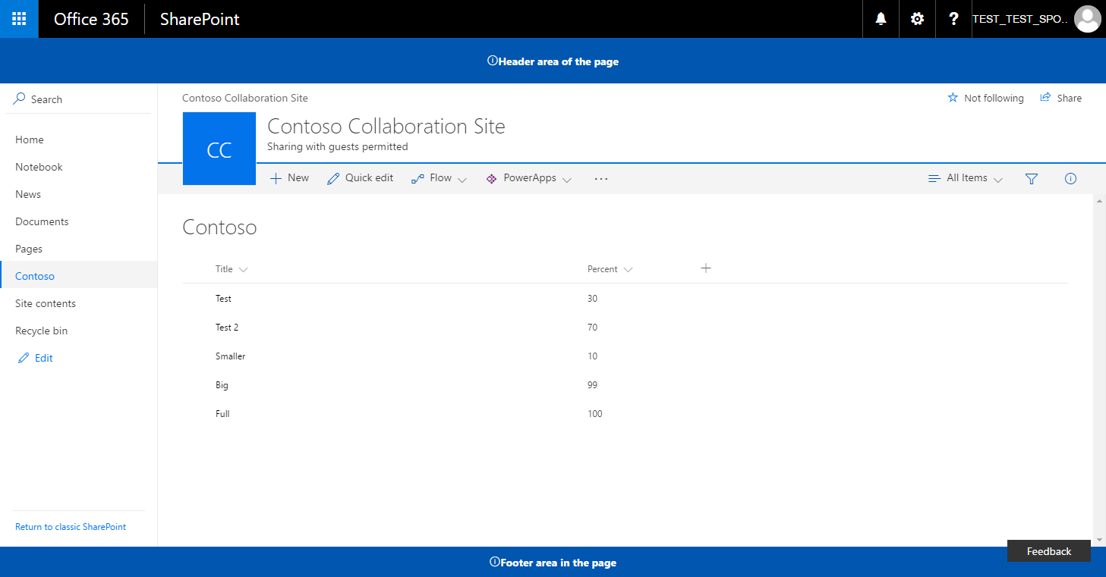
Logical architecture of an extension
SharePoint Online
SharePoint Framework Extension assets hosted from CDN. Could be also a folder or library in the SharePoint tenant, which acts as a centralized deployment location.
Extension
js
JavaScript Library
Extension
9

Slide 10
Application Customizer
Can be used to embed “visible” or hidden JavaScript on the SharePoint site
Can be associated to Site Collection, Site or a List scope
Associated ClientSideComponentId property at UserCustomAction collection
10

Slide 11
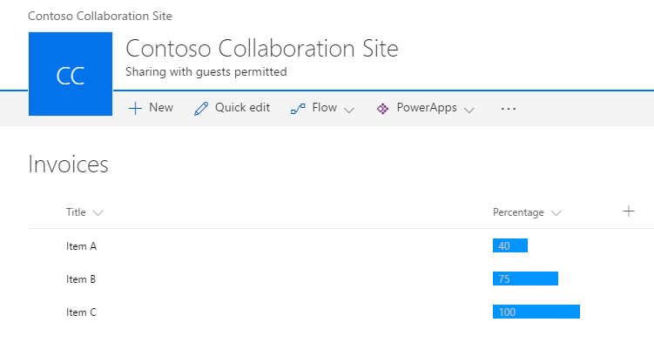
Field Customizer
Can be used to override field presentation in lists
Can be used with site columns or directly for a field in a list
Associated ClientSideComponentId property at Field object
Editing view experience override in the roadmap – June 2017
11

Slide 12
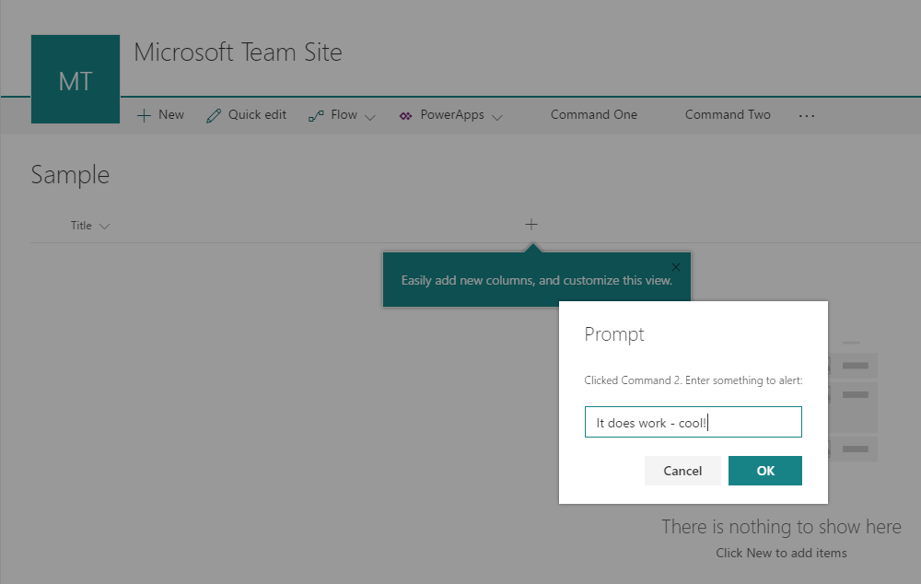
ListView Command Sets
ListView Command Set can be used to provide action buttons to lists
Supports toolbar and context menu
Associated ClientSideComponentId property at UserCustomAction collection
ListView Command Sets can be registered at site level to be valid for specific list types
12

Slide 13
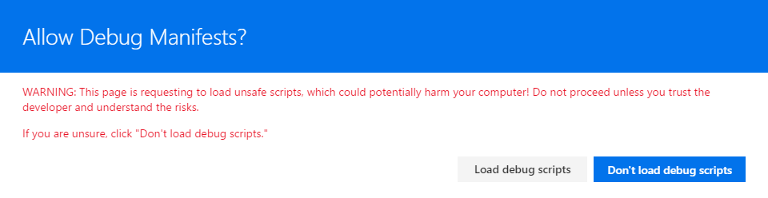
Debugging SharePoint Framework Extension
Debugging
Debugging happens in actual SharePoint Online sites
Code is hosted from the local web server - localhost
You can load your customization to normal pages using specific debug query parameters in browser
C
We are looking to have extension support also in SharePoint Framework workbench
13

Slide 14
Demo
14

Slide 15
Deploying our SharePoint Framework Extension
Package Goes Into App Catalog
Our Bundle(s) needs to be deployed
CDN
SharePoint Library
Add App for our Package
Add Web Part to Page
15

Slide 16

Questions
16

Slide 17
Resources
SharePoint Framework Instructions - https://dev.office.com/sharepoint/docs/spfx/set-up-your-development-environment
User Voice - https://sharepoint.uservoice.com/forums/329220-sharepoint-dev-platform
Code - http://bit.ly/2uqfX6B
https://github.com/SharePoint/sp-dev-fx-extensions
17

Slide 18
Thank You
www.sharepointknight.com
@shrpntknight
ryan@sharepointknight.com

